Slide 1
Natural Language Processing

Slide 2
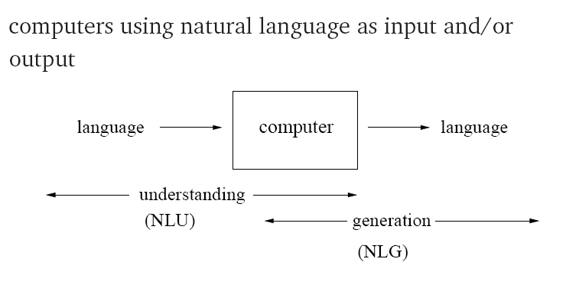
What is Natural Language Processing?

Slide 3
NLP: applications
Speech recognition and synthesis
Machine translation
Document processing
  information extraction
  summarization
Text generation
Dialog systems (typed and spoken)

Slide 4
Levels of language analysis
Phonology: What words (or sub words) are we dealing with?
Morphology: How words are constructed from more basic meaning units?
Syntax: What phrases are we dealing with?
Semantics: What’s the context-free meaning?
Pragmatics: What is the more exact (context-dependent) meaning?
Discourse Knowledge: how the immediately preceding sentences affect the interpretation of the next sentence?
World knowledge: Using general knowledge about the world

Slide 5
Levels of language analysis
Phonetics: sounds -> words
  /b/ + /o/ + /t/ = boat
Morphology: morphemes -> words
  friend + ly = friendly
Syntax: word sequence -> sentence structure
Semantics: sentence structure + word meaning -> sentence meaning
Pragmatics: sentence meaning + context -> more precise meaning
Discourse and world knowledge

Slide 6
Levels of language analysis (cont.)
Language is one of fundamental aspects of human behavior and is crucial component of our lives.
Green frogs have large noses.
Green ideas have large noses.
Large have green ideas nose.
I go store.

Slide 7
Why is NLP Hard?
“At last, a computer that understands you like your mother”

Slide 8
Ambiguity
“At last, a computer that understands you like your mother”
(*) It understands you as well as your mother understands you
It understands (that) you like your mother
It understands you as well as it understands your mother
1 and 3: Does this mean well, or poorly?

Slide 9
Ambiguity at Many Levels
At the acoustic level (speech recognition):
“ ... a computer that understands you like your mother”
“ ... a computer that understands you lie cured mother”

Slide 10
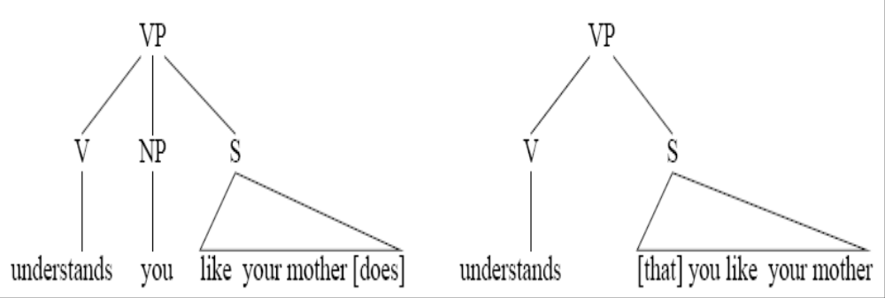
Ambiguity at Many Levels
At the syntactic level:
Different structures lead to different interpretations.

Slide 11
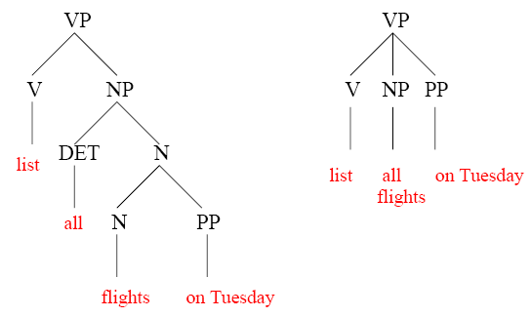
More Syntactic Ambiguity

Slide 12
Ambiguity at Many Levels
At the semantic (meaning) level:
Two definitions of “mother”
a woman who has given birth to a child
a substance consisting of bacteria, used to produce vinegar (i.e., mother of vinegar)
This is an instance of word sense ambiguity

Slide 13
Ambiguity at Many Levels
At the discourse level:
Alice says they’ve built a computer that understands you like your mother
But she ...
... doesn’t know any details
... doesn’t understand me at all

Slide 14
Syntactic analysis
Syntax can make explicit when there are several possible interpretations
  (Rice flies) like sand.
  Rice (flies like sand).
Knowledge of ‘correct’ grammar can help finding the right interpretation
  Flying planes are dangerous.
  Flying planes is dangerous.

Slide 15
Syntax shows how words are related in a sentence.
Visiting aunts ARE boring.
vs
Visiting aunts IS boring.
Subject verb agreement allows us to disambiguate here.

Slide 16
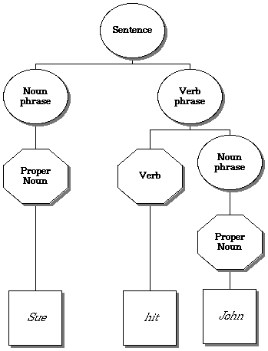
How do we represent syntax?
Parse Tree

Slide 17
An example:
  Parsing sentence:
  "They are cooking apples."

Slide 18
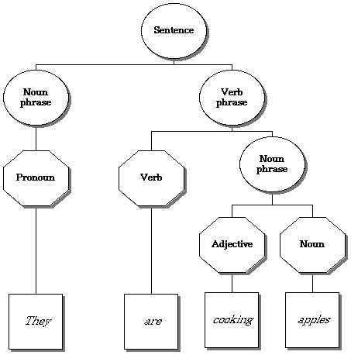
Parse 1

Slide 19
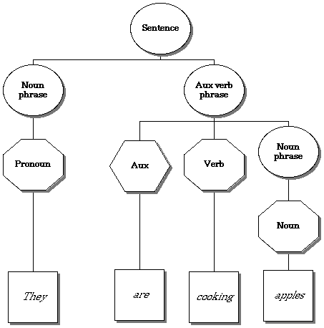
Parse 2

Slide 20
How do we represent syntax?
List
Sue hit John
[ s, [np, [proper_noun, Sue] ] ,
[vp, [v, hit],
[np, [proper_noun, John] ] ] ]

Slide 21
What is Natural Language Processing (NLP)
The process of computer analysis of input provided in a human language (natural language), and conversion of this input into a useful form of representation.
The field of NLP is primarily concerned with getting computers to perform useful and interesting tasks with human languages.
The field of NLP is secondarily concerned with helping us come to a better understanding of human language.

Slide 22
Forms of Natural Language
The input/output of a NLP system can be:
  written text
  speech
We will mostly concerned with written text (not speech).
To process written text, we need:
  lexical, syntactic, semantic knowledge about the language
  discourse information, real world knowledge
To process spoken language, we need everything required to process written text, plus the challenges of speech recognition and speech synthesis.

Slide 23
Components of NLP
Natural Language Understanding
  Mapping the given input in the natural language into a useful representation.
  Different level of analysis required:
  morphological analysis,
  syntactic analysis,
  semantic analysis,
  discourse analysis, …
Natural Language Generation
  Producing output in the natural language from some internal representation.
  Different level of synthesis required:
  deep planning (what to say),
  syntactic generation
NL Understanding is much harder than NL Generation. But, still both of them are hard.

Slide 24
Why NL Understanding is hard?
Natural language is extremely rich in form and structure, and very ambiguous.
  How to represent meaning,
  Which structures map to which meaning structures.
One input can mean many different things. Ambiguity can be at different levels.
  Lexical (word level) ambiguity -- different meanings of words
  Syntactic ambiguity -- different ways to parse the sentence
  Interpreting partial information -- how to interpret pronouns
  Contextual information -- context of the sentence may affect the meaning of that sentence.
Many input can mean the same thing.
Interaction among components of the input is not clear.

Slide 25
Knowledge of Language
Phonology – concerns how words are related to the sounds that realize them.
Morphology – concerns how words are constructed from more basic meaning units called morphemes. A morpheme is the primitive unit of meaning in a language.
Syntax – concerns how can be put together to form correct sentences and determines what structural role each word plays in the sentence and what phrases are subparts of other phrases.
Semantics – concerns what words mean and how these meaning combine in sentences to form sentence meaning. The study of context-independent meaning.

Slide 26
Knowledge of Language (cont.)
Pragmatics – concerns how sentences are used in different situations and how use affects the interpretation of the sentence.
Discourse – concerns how the immediately preceding sentences affect the interpretation of the next sentence. For example, interpreting pronouns and interpreting the temporal aspects of the information.
World Knowledge – includes general knowledge about the world. What each language user must know about the other’s beliefs and goals.

Slide 27
Ambiguity
I made her duck.
How many different interpretations does this sentence have?
What are the reasons for the ambiguity?
The categories of knowledge of language can be thought of as ambiguity resolving components.
How can each ambiguous piece be resolved?
Does speech input make the sentence even more ambiguous?
  Yes – deciding word boundaries

Slide 28
Ambiguity (cont.)
Some interpretations of : I made her duck.
  I cooked duck for her.
  I cooked duck belonging to her.
  I created a toy duck which she owns.
  I caused her to quickly lower her head or body.
  I used magic and turned her into a duck.
duck – morphologically and syntactically ambiguous:
noun or verb.
her – syntactically ambiguous: dative or possessive.
make – semantically ambiguous: cook or create.
make – syntactically ambiguous:
  Transitive – takes a direct object. => 2
  Di-transitive – takes two objects. => 5
  Takes a direct object and a verb. => 4

Slide 29
Resolve Ambiguities
We will introduce models and algorithms to resolve ambiguities at different levels.
part-of-speech tagging -- Deciding whether duck is verb or noun.
word-sense disambiguation -- Deciding whether make is create or cook.
lexical disambiguation -- Resolution of part-of-speech and word-sense ambiguities are two important kinds of lexical disambiguation.
syntactic ambiguity -- her duck is an example of syntactic ambiguity, and can be addressed by probabilistic parsing.

Slide 30
Resolve Ambiguities (cont.)
I made her duck
S S
NP VP NP VP
I V NP NP I V NP
made her duck made DET N
her duck

Slide 31
Models to Represent Linguistic Knowledge
We will use certain formalisms (models) to represent the required linguistic knowledge.
State Machines -- FSAs, FSTs, HMMs, ATNs, RTNs
Formal Rule Systems -- Context Free Grammars, Unification Grammars, Probabilistic CFGs.
Logic-based Formalisms -- first order predicate logic, some higher order logic.
Models of Uncertainty -- Bayesian probability theory.

Slide 32
Algorithms to Manipulate Linguistic Knowledge
We will use algorithms to manipulate the models of linguistic knowledge to produce the desired behavior.
Most of the algorithms we will study are transducers and parsers.
  These algorithms construct some structure based on their input.
Since the language is ambiguous at all levels,
these algorithms are never simple processes.
Categories of most algorithms that will be used can fall into following categories.
  state space search
  dynamic programming

Slide 33
Language and Intelligence
Turing Test
Computer Human
Human Judge
Human Judge asks tele-typed questions to Computer and Human.
Computer’s job is to act like a human.
Human’s job is to convince Judge that he is not machine.
Computer is judged “intelligent” if it can fool the judge
Judgment of intelligence is linked to appropriate answers to questions from the system.

Slide 34
NLP - an inter-disciplinary Field
NLP borrows techniques and insights from several disciplines.
Linguistics: How do words form phrases and sentences? What constraints the possible meaning for a sentence?
Computational Linguistics: How is the structure of sentences are identified? How can knowledge and reasoning be modeled?
Computer Science: Algorithms for automatons, parsers.
Engineering: Stochastic techniques for ambiguity resolution.
Psychology: What linguistic constructions are easy or difficult for people to learn to use?
Philosophy: What is the meaning, and how do words and sentences acquire it?

Slide 35
Some Buzz-Words
NLP – Natural Language Processing
CL – Computational Linguistics
SP – Speech Processing
HLT – Human Language Technology
NLE – Natural Language Engineering
SNLP – Statistical Natural Language Processing
Other Areas:
  Speech Generation, Text Generation, Speech Understanding, Information Retrieval,
  Dialogue Processing, Inference, Spelling Correction, Grammar Correction,
  Text Summarization, Text Categorization,

Slide 36
Some NLP Applications
Machine Translation – Translation between two natural languages.
  See the Babel Fish translations system on Alta Vista.
Information Retrieval – Web search (uni-lingual or multi-lingual).
Query Answering/Dialogue – Natural language interface with a database system, or a dialogue system.
Report Generation – Generation of reports such as weather reports.
Some Small Applications –
  Grammar Checking, Spell Checking, Spell Corrector

Slide 37
Brief History of NLP
1940s –1950s: Foundations
  Development of formal language theory (Chomsky, Backus, Naur, Kleene)
  Probabilities and information theory (Shannon)
1957 – 1970s:
  Use of formal grammars as basis for natural language processing (Chomsky, Kaplan)
  Use of logic and logic based programming (Minsky, Winograd, Colmerauer, Kay)
1970s – 1983:
  Probabilistic methods for early speech recognition (Jelinek, Mercer)
  Discourse modeling (Grosz, Sidner, Hobbs)
1983 – 1993:
  Finite state models (morphology) (Kaplan, Kay)
1993 – present:
  Strong integration of different techniques, different areas.

Slide 38
Natural Language Understanding
Words
Morphological Analysis
Morphologically analyzed words (another step: POS tagging)
Syntactic Analysis
Syntactic Structure
Semantic Analysis
Context-independent meaning representation
Discourse Processing
Final meaning representation

Slide 39
Natural Language Generation
Meaning representation
Utterance Planning
Meaning representations for sentences
Sentence Planning and Lexical Choice
Syntactic structures of sentences with lexical choices
Sentence Generation
Morphologically analyzed words
Morphological Generation
Words

Slide 40
Morphological Analysis
Analyzing words into their linguistic components (morphemes).
Morphemes are the smallest meaningful units of language.
cars car+PLU
giving give+PROG
geliyordum gel+PROG+PAST+1SG - I was coming
Ambiguity: More than one alternatives
flies fly_{VERB}+PROG
fly_{NOUN}+PLU
adamı adam+ACC - the man (accusative)
adam+P1SG - my man
ada+P1SG+ACC - my island (accusative)

Slide 41
Morphological Analysis (cont.)
Relatively simple for English. But for some languages such as Turkish, it is more difficult.
uygarlaştıramadıklarımızdanmışsınızcasına
uygar-laş-tır-ama-dık-lar-ımız-dan-mış-sınız-casına
uygar +BEC +CAUS +NEGABLE +PPART +PL +P1PL +ABL +PAST +2PL +AsIf
“(behaving) as if you are among those whom we could not civilize/cause to become civilized”
  +BEC is “become” in English
  +CAUS is the causative voice marker on a verb
  +PPART marks a past participle form
  +P1PL is 1st person plural possessive marker
  +2PL is 2nd person plural
  +ABL is the ablative (from/among) case marker
  +AsIf is a derivational marker that forms an adverb from a finite verb form
  +NEGABLE is “not able” in English
Inflectional and Derivational Morphology.
Common tools: Finite-state transducers

Slide 42
Part-of-Speech (POS) Tagging
Each word has a part-of-speech tag to describe its category.
Part-of-speech tag of a word is one of major word groups
(or its subgroups).
  open classes -- noun, verb, adjective, adverb
  closed classes -- prepositions, determiners, conjuctions, pronouns, particples
POS Taggers try to find POS tags for the words.
duck is a verb or noun? (morphological analyzer cannot make decision).
A POS tagger may make that decision by looking the surrounding words.
  Duck! (verb)
  Duck is delicious for dinner. (noun)

Slide 43
Lexical Processing
The purpose of lexical processing is to determine meanings of individual words.
Basic methods is to lookup in a database of meanings -- lexicon
We should also identify non-words such as punctuation marks.
Word-level ambiguity -- words may have several meanings, and the correct one cannot be chosen based solely on the word itself.
  bank in English
  yüz in Turkish
Solution -- resolve the ambiguity on the spot by POS tagging (if possible) or pass-on the ambiguity to the other levels.

Slide 44
Syntactic Processing
Parsing -- converting a flat input sentence into a hierarchical structure that corresponds to the units of meaning in the sentence.
There are different parsing formalisms and algorithms.
Most formalisms have two main components:
  grammar -- a declarative representation describing the syntactic structure of sentences in the language.
  parser -- an algorithm that analyzes the input and outputs its structural representation (its parse) consistent with the grammar specification.
CFGs are in the center of many of the parsing mechanisms. But they are complemented by some additional features that make the formalism more suitable to handle natural languages.

Slide 45
Semantic Analysis
Assigning meanings to the structures created by syntactic analysis.
Mapping words and structures to particular domain objects in way consistent with our knowledge of the world.
Semantic can play an import role in selecting among competing syntactic analyses and discarding illogical analyses.
  I robbed the bank -- bank is a river bank or a financial institution
We have to decide the formalisms which will be used in the meaning representation.

Slide 46
Knowledge Representation for NLP
Which knowledge representation will be used depends on the application -- Machine Translation, Database Query System.
Requires the choice of representational framework, as well as the specific meaning vocabulary (what are concepts and relationship between these concepts -- ontology)
Must be computationally effective.
Common representational formalisms:
  first order predicate logic
  conceptual dependency graphs
  semantic networks
  Frame-based representations

Slide 47
Discourse
Discourses are collection of coherent sentences (not arbitrary set of sentences)
Discourses have also hierarchical structures (similar to sentences)
anaphora resolution -- to resolve referring expression
  Mary bought a book for Kelly. She didn’t like it.
    She refers to Mary or Kelly. -- possibly Kelly
    It refers to what -- book.
  Mary had to lie for Kelly. She didn’t like it.
Discourse structure may depend on application.
  Monologue
  Dialogue
  Human-Computer Interaction

Slide 48
Natural Language Generation
NLG is the process of constructing natural language outputs from non-linguistic inputs.
NLG can be viewed as the reverse process of NL understanding.
A NLG system may have two main parts:
  Discourse Planner -- what will be generated. which sentences.
  Surface Realizer -- realizes a sentence from its internal representation.
Lexical Selection -- selecting the correct words describing the concepts.

Slide 49
Machine Translation
Machine Translation -- converting a text in language A into the corresponding text in language B (or speech).
Different Machine Translation architectures:
  interlingua based systems
  transfer based systems
How to acquire the required knowledge resources such as mapping rules and bi-lingual dictionary? By hand or acquire them automatically from corpora.
Example Based Machine Translation acquires the required knowledge (some of it or all of it) from corpora.

